Slide 1
The Evolution of "Brand": How U.S. Shoppers Have Helped Create the New Wave of Private Label
Diana Sheehan
April 6, 2016

Slide 3
Agenda
Growth and Trends
Private Label on the Ground
What to Do Back at Home

Slide 4
Why Do Retailers Invest in Private Brands?
Finance
Brand
Operations
Source: Kantar Retail analysis

Slide 5
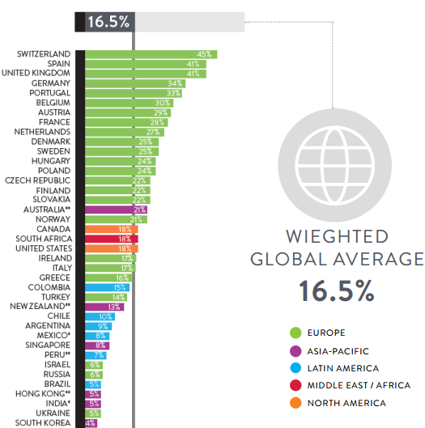
Private Label Growth and Trends at a Glance
US: 18%
Source: PLMA‘s 2016 Private Label Yearbook, 2016 Sales are Kantar Retail Projection

Slide 6
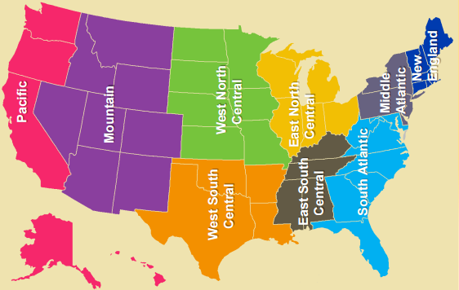
Significant Regional Variations Exist within the US
Dollar* and Unit Share of Private Label by Region
The Coasts lag the rest of the US
*Dollar Share is top line in graphic and Unit Share is bottom line, Data for 2015
Source: PLMA‘s 2016 Private Label Yearbook

Slide 7
Private Label Already Captured Staple Categories
The next opportunity is smart center-store expansion and HBC
Last Purchase: National vs. Private Brand
(among shoppers who ever purchase category)
Source: Kantar Retail ShopperScape®, February 2017

Slide 8
The Foundations Behind Your Private Brands
Reasons for Purchasing Private Label Food/Beverage Products Instead of National/Name Brand
(among shoppers purchased private label last time they purchased category; weighted average across 15 food/beverage categories)
Gen Y
Boomers
48% | 53%
25% | 39%
22% | 32%
20% | 27%
19% | 26%
20% | 19%
12% | 13%
9% | 4%
8% | 4%
9% | 4%
4% | 4%
5% | 3%
Note: Arrows indicate significant difference vs. all private label purchasers (95% confidence level)
Source: Kantar Retail ShopperScape®, February 2017

Slide 9
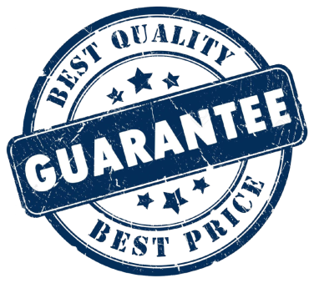
How Do Shoppers Trust Brands?
 | All Shoppers | Gen Y | Gen X | Baby Boomers | Seniors
I trust that retailers are taking the necessary steps to ensure the quality of the products they offer | 57% | 57% | 57% | 56% | 57%
I trust that brands are taking the necessary steps to ensure the quality of the products they offer | 57% | 56% | 59% | 57% | 57%
I trust that retailers will remove a product from their shelves if they feel it's unsafe | 61% | 59% | 60% | 63% | 61%
I am willing to spend more for a product that makes a specific safety guarantee | 42% | 47% | 43% | 38% | 42%
I prefer to shop at retailers that are transparent about product quality | 63% | 64% | 61% | 63% | 63%
I am willing to spend more on a brand I trust | 61% | 69% | 62% | 57% | 61%
Source: Kantar Retail ShopperScape®, March 2016
Shading indicate significant difference from all shoppers

Slide 10
A Useful Tool For Understanding Private Label
Incandescent
Gross Margin
OPP competition
Sourcing flexibility
Merch ladder
Leverages the value proposition inherent in Private Label Image → $
Emphasize trust and garner brand loyalty; seen as equals or superiors to major, respected national brands
Banner image
Innovation
Differentiation
Loyalty
Source of PL Power
Retailer’s Motivation
Relies on national brand’s equity
Similar graphics, ingredients
Invites price/value comparison
Finance
Budget brands offering low-priced alternatives to commoditized products
These brands leverage A brand’s image, co-opting the strength of that brand
Brand
Makes its own “light”
Unique ingredients, packaging
Limits comparability
Often cross-category umbrella
Trade Down
Reflective
Source: Kantar Retail research and analysis

Slide 11
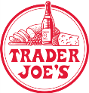
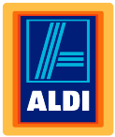
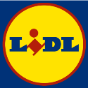
How Can We Think About Well Known Private Labels Today?
Incandescent
Source of PL Power
Retailer’s Motivation
Finance
Brand
Reflective
Source: Kantar Retail research and analysis

Slide 12
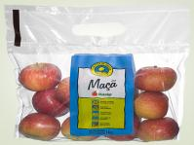
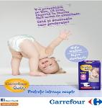
Carrefour Supports Differentiated Go-To-Market Strategies by Market
A Staged Approach to Consolidate Brand Equity and Leverage Margins
Asia
Latin America
Eastern Europe
Western Europe
Substitute
Localize
Diversify
Differentiate
Emerging markets balance a high A Brand shopper affinity on one hand and a high value orientation on the other. Carrefour employs private label to tackle the value extreme while it’s building its brand equity in the market.
Carrefour pursues its strategy to consolidate its brand equity by leveraging established local sourcing to elevate its ranges.
As its quality and value proposition shape up Carrefour employs private label to manage margins in key categories. Private label tiering becomes more complex as new products come to broaden the shopper’s choice.
As markets become increasingly competitive and shoppers have more choice Carrefour elevates its private label offer to higher margin categories.
Source: Kantar Retail research and analysis

Slide 13
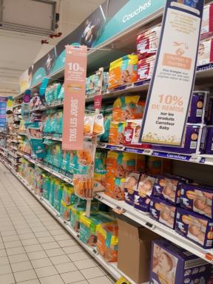
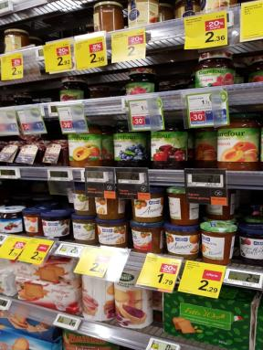
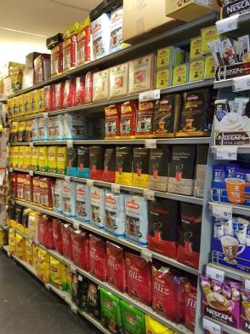
Tailored Pricing and Promotions Support Carrefour’s Private Labels
Developed markets rely more on programs, while hybrid and emerging markets reinforce quality and price
10% credit on Carrefour Baby products – Carrefour France
30% credit on second product purchased – Carrefour Italy
Highlighted PL products on shelves – Carrefour Poland
Eye level placement on shelves – Carrefour Express Turkey
Source: Kantar Retail store visits and analysis

Slide 14
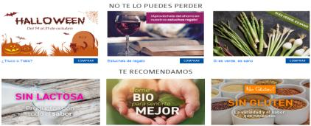
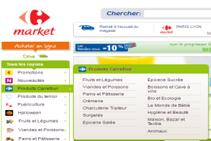
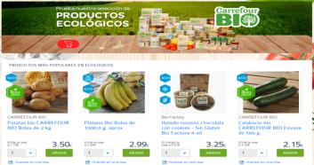
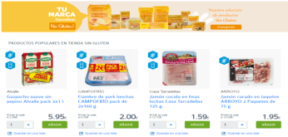
Carrefour’s PL Granted High Visibility in Online Assortment
Consolidating Quality Proposition
Reinforcing Growth Categories
RDF is featured in the “International” products category in China, further elevating its brand position.
Carrefour Spain sustains impulse and elevates private label brands in niche key growth categories.
Promoting as Standalone Offer
The private label offer has dedicated sections facilitating access to the ranges.
Source: Kantar Retail store visits and analysis
14

Slide 15
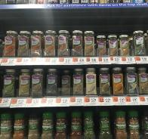
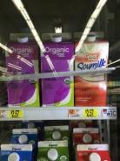
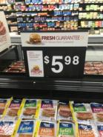
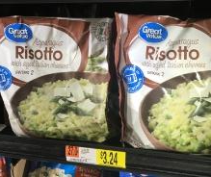
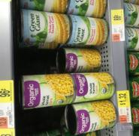
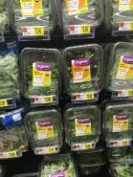
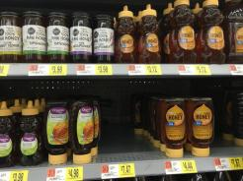
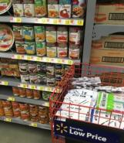
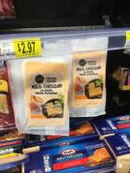
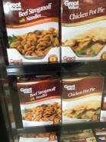
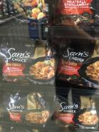
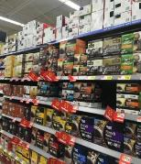
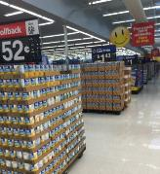
Price Positioning, Promotions, and Organic Critical to Walmart Grocery PL
PL level varies by category; prevalent in spices/milk with non/organic option
“Fresh guarantee”
More premium option but sill reflective, quality and organic even extend to most generic portions of PL
Ready-to-eat options, same as national brands
Adjacent positioning and lower pricing with national brands
PL as lower priced “gap-filler”
Sam’s Choice differentiates against other PLs and national brands with better packaging and quality but higher pricing
PL more emphasized than national brands on rollbacks and promotions
Source: Kantar Retail research, analysis and store visits

Slide 16
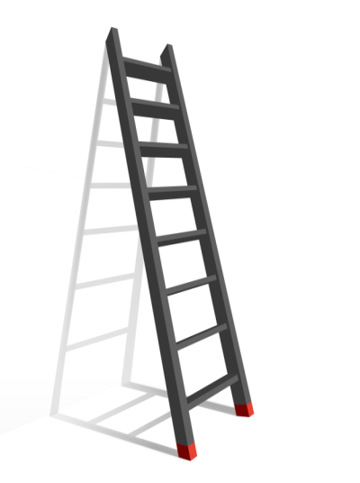
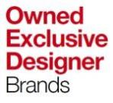
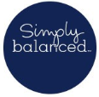
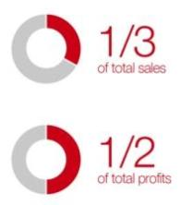
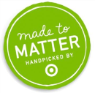
Target Pursues a Highly Differentiated Private Label Strategy
Grocery
Home
Apparel
Best
Better
Good
Source: Company reports; Kantar Retail research and analysis

Slide 17
Amazon Private Label History in a Nutshell
Strathwood
Outdoor patio, lawn, & garden
Denali
Amazon Elements
DIY tools & accessories
Premium-positioned baby wipes sold exclusively to Prime members
Happy Belly, Mama Bear and more…
Opened multiple consumable brands for detergent, coffee, nuts and more all available exclusively to Prime members
2004
2006
2014
2005
2009
Amazon Fashion
2016
Pinzon
7 private label apparel lines: Franklin & Freeman, Franklin Tailored, James & Erin, Lark & Ro, North Eleven, Scout + Ro, and Society New York
Bedding, bath, home furnishings
Pike Street products (also launched 2005) re-branded under Pinzon
Amazon Basics
Started in consumer electronics accessories and home and office supplies
Expanded to general merchandise, including fitness, home & pet supplies
Source: Kantar Retail analysis; Company Website
Source: Kantar Retail research and analysis; Amazon.com

Slide 18
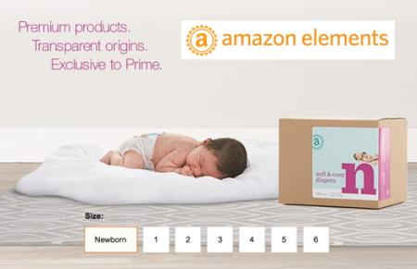
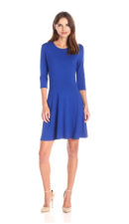
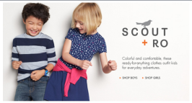
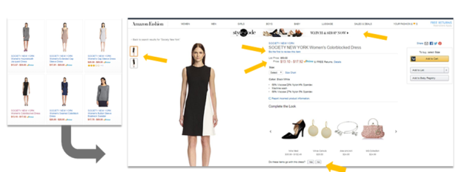
Amazon Has Had Both Successes and Missteps
“From work dresses to weekend wear, our polished wardrobe essentials serve up effortless style”
Sustainable
Scannable packaging for more Info
Transparent
Sets precedent for future brands
Source: Kantar Retail research and analysis; media reports; Amazon.com

Slide 19
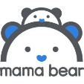
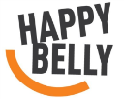
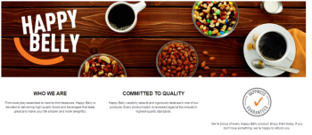
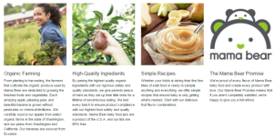
Amazon’s Foray Into Consumables Takes an Experimental Approach
Differentiation
New brands could means opportunity for co-branding for suppliers
New brands this year and beyond…
Summer | Summer | Fall
Organic Baby Food | Coffee Nuts Trail Mix | Sustainable Laundry Detergent
Amazon currently only stocks about 10 Happy Belly and 3 Mama Bear SKUs.
Consolidation
These brands could transition to Amazon Elements or remain brands in their own right
All of these newer brands are exclusive to Prime members and can be seen as additional feeders for membership renewals. At this point, they represent a shift away from “Amazon” branding but maintain the same focus on quality, sustainability, sourcing, and transparency that has marked other PLs.
These brands are a long-term threat as Amazon further test private label waters in more categories to discover the best method of building equity.
Source: Kantar Retail research and analysis; company reports; Amazon.com

Slide 20
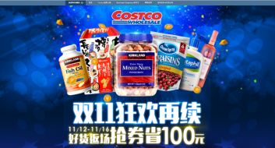
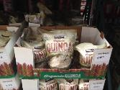
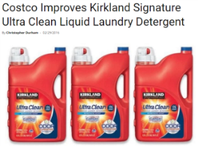
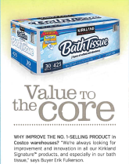
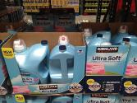
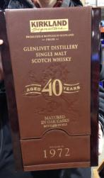
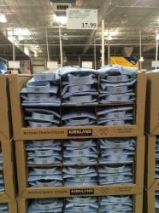
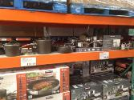
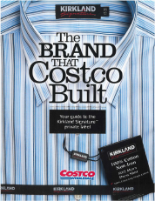
Kirkland Signature Is Always Evolving To Maximize Value and Quality
Costco sold $3.5 million on its first Single’s Day in China through Alibaba, helped by the wide brand recognition KS had among Chinese shoppers in advance of the site’s 2014 launch
Items are continuously being improved in regards to price, formulation, and packaging
KS Bath Tissue is the best selling item at Costco
KS expands into any category where there is an opportunity and embodies the Costco brand. Members trust KS products to be high-quality, well-priced, and relevant to their lives.
KS is well-known both for the occasional uber-premium products like a $600 bottle of Glenlivet and high quality products in bulk such a men’s shirts.
Source: mypbrand.com; Costco publications

Slide 21
Sam’s Club: Revamping Private Label – An Opportunity and Threat
Start
20 different brands
Phase 1
Phase 2
Chandra Holt announces changes
Double PL team from 30 to 60
Have added 300 Member’s Mark items
Total of 770 Member’s Mark items, no other private labels
573 items
12 brands
166 Member’s Mark
Have added 300 Member’s Mark items
Feb. 2016
Aug. 2016
Dec. 2016
Dec. 2017
Source: Kantar Retail research and analysis, company reports

Slide 22
ALDI and Lidl Are the Ultimate Private Label Manifestation
If the financial model extends beyond a product brand to include the entire store, then the model changes
Branded Alignment
Discount Prices
No Sacrifice in Quality
Conclusion: These stores are well positioned for growth
Global
 | Sales |  |  | Sales Growth CAGR |  | Stores
 | 2016E | 2018E | 2021E | 2016-2018 | 2018-2020 | 2016E | 2018E | 2020E
Aldi | $ 107.1 | $ 124.3 | $ 141.4 | 7.7% | 6.7% | 11,170 | 11,757 | 12,340
Lidl | $ 95.3 | $ 111.3 | $ 128.6 | 8.1% | 7.5% | 10,888 | 11,491 | 12,194
USA
 | Sales |  |  | Sales Growth CAGR |  | Stores
 | 2016E | 2018E | 2020E | 2016-2018 | 2018-2020 | 2016E | 2018E | 2020E
Aldi | $ 13.9 | $ 17.2 | $ 20.6 | 11.2% | 9.4% | 1,557 | 1,767 | 1,982
Trader Joe's | $ 10.8 | $ 12.7 | $ 14.9 | 8.4% | 8.3% | 486 | 535 | 568
Lidl | - | $ 0.7 | $ 3.8 | - | 140.5% | - | 120 | 330
Lidl’s US headquarters and DCs
Source: Kantar Retail store visits; KRiQ Report Builder

Slide 23
Simple Truth: The Transcendent Brand of the Future
The power of $1.7B to a retailer struggling to grow
Source: Kantar Retail analysis

Slide 24
Things to Remember: Shoppers Are Changing!
Shoppers are Embracing Private Label
Retailers are Adding Premium Appeals to their Labels
Private Labels Can Be as Trusted as National Brands
Private Brands Can Be a Bellwether for a Retailer’s Strategy
Don’t Forget: New Challenges Can Mean Fresh Opportunities
The Opportunity Has Never Been Better
Source: Kantar Retail research and analysis

Slide 25
Register today!
Planning Conference
(previously Mid Year Forum)
Essential Insights to Drive Growth
May 24-25 Chicago, IL
Join Kantar Retail cross-channel thought leaders for a two-day event designed provide you with planning frameworks to customize your retailer plans. Assortment, promotions, pricing, and retailer segmentation are all
under intense scrutiny. This Conference will feature
Kantar Retail’s latest synthesis of macroeconomic,
shopper, and retailer insights to guide 2018+ plans.
To register visit https://KRevents.cvent.com/PlanningConference or email events@kantarretail.com.

Slide 26
For further information please refer to www.kantarretailiq.com
Contact:
Diana Sheehan
T: +1 (708) 250 3693
Diana.Sheehan@KantarRetail.com
@KR_DianaS
@kantarretail
www.kantarretail.com

