Slide 1
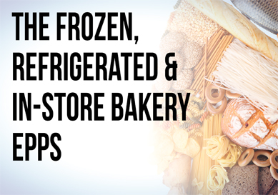
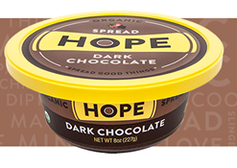
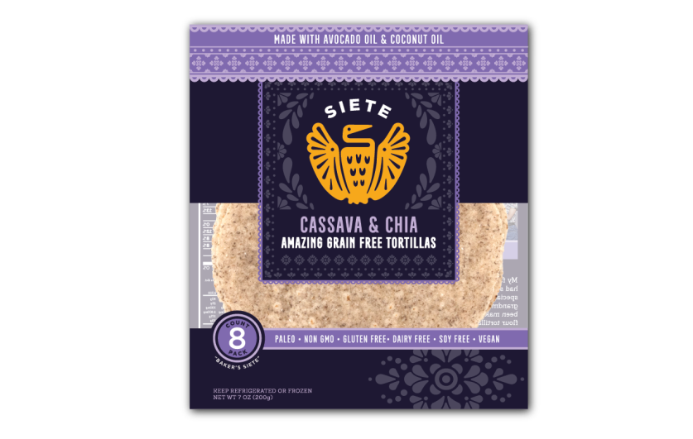
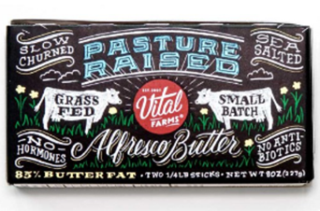
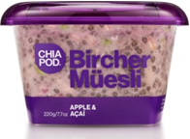
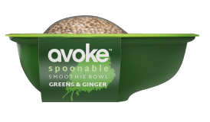
San Diego, August 21, 2016
Health & Wellness Innovation Around the Perimeter
David Sprinkle,
Research Director, Packaged Facts
dsprinkle@marketresearch.com

Slide 2
Health & Wellness Innovation Around the Perimeter
what do consumers want?
perimeter tour
takeaways

Slide 3
“The food products I buy when grocery shopping have changed significantly, compared with 10 years ago,” 2016 (percent of U.S. shoppers age 30+)
Strongly disagree | 4%
Somewhat disagree | 8
Neither agree/disagree | 23
Somewhat agree | 39
Strongly agree | 26
Source: Packaged Facts National Consumer Survey, February 2016
Notes:
We are experiencing a food industry revolution.

Slide 4
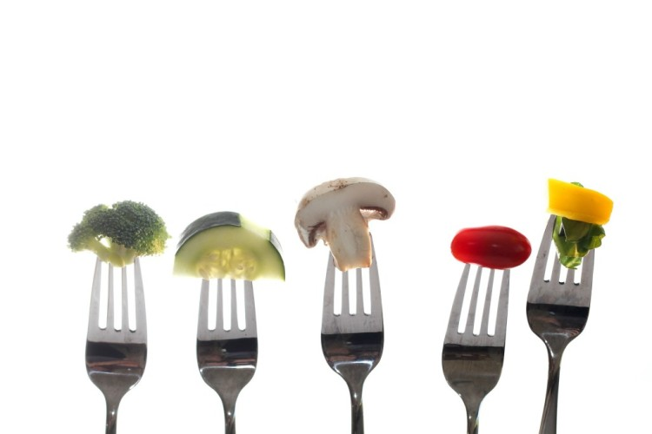
“I try to eat healthier foods these days,” Winter 2015-16 (percent of U.S. adults by level of agreement;
breakout by generational cohort)
DISAGREE A LOT | 5%
DISAGREE A LITTLE | 7
NEITHER AGREE/DISAGREE | 21
AGREE A LITTLE | 38
AGREE A LOT | 25
 | Agree a Lot | Agree a Little
Age 18-34 (Millennials) | 20% | 35%
Age 35-49 (Gen X) | 24% | 39%
Age 50-69 (Boomers) | 28% | 40%
Age 70+ | 29% | 37%
Source: Simmons National Consumer Survey, Winter 2015-16
Notes:
Driving the food revolution is consumers’ desire to eat healthier. U.S. adult consumer are over five times more likely to agree than to disagree that they are trying to eat healthier. This desire takes different forms (some substantive, some ephemeral), but remains a permanent feature of the food industry landscape and the primary growth driver.

Slide 5
Supermarkets shopped in last 4 weeks, 2005-2015 (in millions of U.S. adults)
 | 2005 | 2010 | 2015 |  | # Chg | % Chg
Overall | 211.4 | 223.8 | 236.6 |  | 25.2 | 11.9%
Walmart | 104.6 | 132.3 | 140.3 |  | 35.7 | 34.1%
Kroger | 28.7 | 33.2 | 32.1 |  | 3.4 | 11.8%
Safeway | 19.4 | 22.0 | 23.0 |  | 3.6 | 18.6%
Food Lion | 12.8 | 16.1 | 13.3 |  | 0.5 | 3.9%
Winn-Dixie | 17.0 | 12.5 | 10.9 |  | -6.1 | -35.9%
Albertsons | 26.7 | 19.5 | 15.5 |  | -11.2 | -41.9%
Trader Joe’s | 10.9 | 15.8 | 24.2 |  | 13.3 | 122.0%
Whole Foods | 5.7 | 11.2 | 15.3 |  | 9.6 | 168.4%
Source: Simmons National Consumer Fall Surveys
Notes:
At the overall retail landscape level, healthier eating concerns are driving the customer base growth of natural channel supermarkets Trader Joe’s and Whole Foods.

Slide 6
U.S. Retail Sales of Organic Foods and Beverages (in billions of dollars and % chg)
U.S. Retail Sales of Gluten-Free Foods in Key Categories (in millions of dollars and % chg)
 | Sales ($B) | % Chg
2015 | $38.1 | 12.0%
2014 | 34.0 | 12.5
2013 | 30.2 | 11.5
2012 | 27.1 | 10.0
2011 | 24.6 | 9.0
2010 | 22.6 | 7.5
 | Sales ($M) | % Chg
2015 | $1,233 | 20%
2014 | 973.2 | 20
2013 | 810.8 | 48
2012 | 547.6 | 42
2011 | 385.1 | 27
2010 | 303.5 | --
Packaged Facts, Natural and Organic Foods & Beverages (July 2014)
Packaged Facts, Gluten-Free Foods in the U.S. (January 2015)
Notes:
Healthy eating concerns are also driving a willingness to pay more for food products perceived as better for you, including an important role for ingredient avoidances, as evident in sales growth for organic and gluten-free.

Slide 7
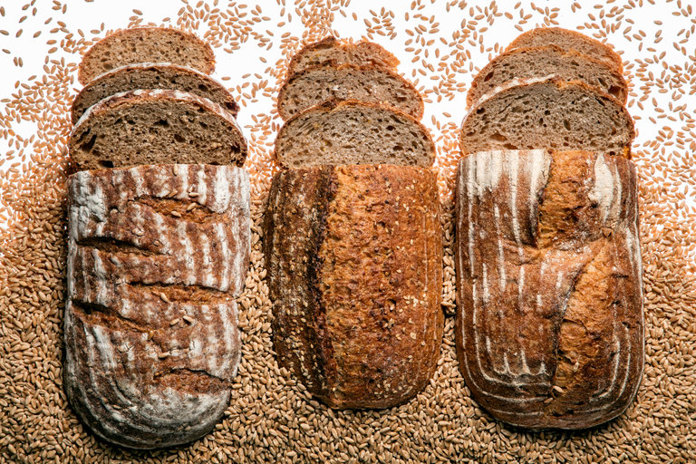
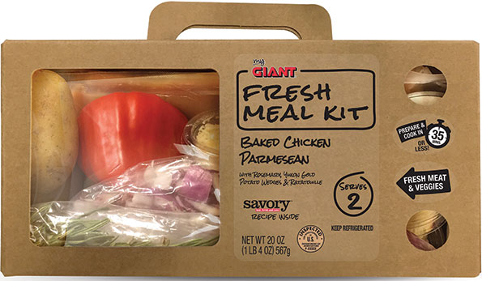
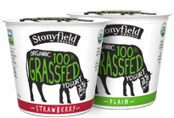
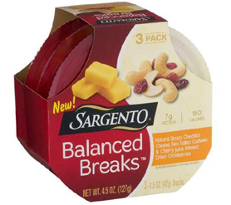
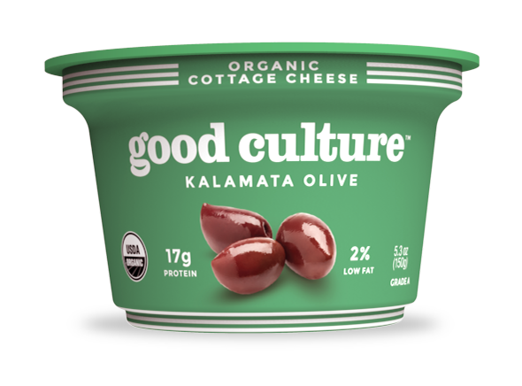
Percent of U.S. Shoppers Who Switched to Healthier Version in Past 12 Months, 2016
Bread | 33%
Dairy Products | 31%
Cold Cereal | 28%
Bottled/Canned Beverages | 28%
Frozen Meals/Sides | 26%
Meat/Poultry | 25%
Oil | 24%
Salty Snacks/Crackers | 24%
Pasta/Noodles | 22%
Hot Cereal | 22%
Soups | 21%
Sauces/Dressings | 20%
Source: Packaged Facts National Consumer Survey, February 2016
Notes:
We can see this in FMI data about switching to healthier oils.

Slide 8
what do consumers want?

Slide 9
“Naturally occurring nutrients are better for you than nutrients added in processed foods,” 2015
(percent of U.S. shoppers by level of agreement)
 | Overall
Strongly disagree | 2%
Somewhat disagree | 3
Neither agree nor disagree | 31
Somewhat agree | 41
Strongly agree | 31
Source: Packaged Facts Consumer Insights Survey, January 2015
Notes:
Third, a clean label paradigm has emerged among consumers that is characterized by prizing fresh, natural, whole foods; a faith in natural nutrition; distrust of highly processed foods and artificial additives; and often strong ingredient avoidances.

Slide 10
“When it comes to packaged food and beverage products, the fewer ingredients the better,” 2016 (percent of U.S. shoppers by level of agreement)
Strongly disagree | 3%
Somewhat disagree | 5
Neither agree nor disagree | 27
Somewhat agree | 36
Strongly agree | 29
Source: Packaged Facts National Consumer Survey, April 2016
Notes:
Distrust of food processing and of artificial additives leads to the product ingredient lists coming under harsh scrutiny, even including a sort of cap on number of ingredients, which is a shorthand way of seeking out more natural products and putting the brakes on food processing.
(will update this stat)

Slide 11
When choosing which packaged food or beverage products to buy,
which of the following are very important to you?, 2015 (percent of U.S. shoppers)
Ingredient list | 52%
Nutrition facts panel | 50
Flavor variety | 45
Ingredient-free statements | 35
Ingredient benefit statements | 32
Brand | 32
Source: Packaged Facts National Consumer Survey, January 2015
Notes:
We can see the new focus on ingredients in the way cooking spray oils are featuring the type of oil, not the brand or the non-stick function

Slide 12
Are any of the following especially important to you in choosing the foods you eat?, (percent of U.S. shoppers)
Source: Packaged Facts National Consumer Survey, February 2016
Notes:
Wow! for healthy fats and oils.

Slide 13
“Certain fats and oils are important to healthy eating,” 2015 (percent of U.S. shoppers by level of agreement)
 | Overall | Women | Men
Strongly disagree | 1% | 1% | 1%
Somewhat disagree | 2 | 2 | 2
Neither agree/disagree | 21 | 19 | 23
Somewhat agree | 41 | 39 | 44
Strongly agree | 34 | 39 | 29
Source: Packaged Facts Consumer Insights Survey, January 2015
Notes:
Nonetheless, there has been a dramatic paradigm shift whereby consumers increasingly recognize the positive nutritional role of oils in the diet.

Slide 14
the percent of adults who are purchasing high-protein foods in conjunction with dieting/watching their diet is on the rise
U.S. Adults Purchasing High Protein Foods in Relation to Watching Diet
 |  | 2012 | 2013 | 2014 | 2015
Watching Diet | # of Adults (000) | 117,245 | 121,048 | 122,672 | 122,198
 | % of Adults | 51.3% | 52.3% | 52.4% | 51.6%
Purchasing High-Protein Foods in Relation to Watching Diet | # of Adults(000) | 27,232 | 29,961 | 31,146 | 35,175
 | % of Adults | 11.9% | 12.9% | 13.3% | 14.9%
Source: Compiled by Packaged Facts from Fall 2015 Simmons NCS

Slide 15
Attributes | Nutrition
Fresh/Whole/Local/Seasonal | Superfoods
Natural/Organic/Clear Label | Proteins
Authentic, Artisan | Grains
International/Regional | Fibers
Sustainable, Eco, Humane | Vegetarian Choices
Innovation, Boldness | Healthy Fats
Indulgence | Probiotics
Convenience | Vitamins/M/S
Highly Processed | Sugar
Artificial Ingredients | Salt
Pesticides
GMO/Hormones/Antibiotics | Unhealthy/Excess Fats
Trans Fats/HFCS | Unhealthy/Excess Carbs
Gluten/Allergens | Excess Calories

Slide 16
perimeter tour

Slide 17
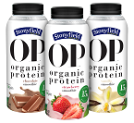
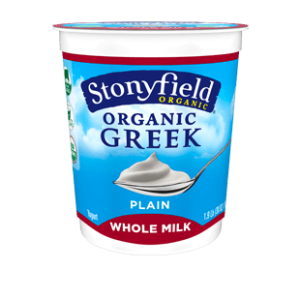
Selected Stonyfield Farm Yogurt Products
1995: Organic (previously natural) 1995: Planet Protector Kids Yogurt (reusable cups for lunchboxes)
1996: Nonfat Yogurt--Apricot Mango
1996: Dessert Yogurts—Mocha Fudge
1997: Hormone Free
1998: With “six healthful cultures”
1999: Yo Baby Organic
2000: YoSqueeze (portable tube)
2001: Fruit Blends Lowfat Yogurt (with inulin fiber)
2001: O’Soy (non-dairy)
2001: Drinkables
2003: Squeezers
2003: O’Soy fruit-on-the-bottom
2003: Organic Smoothie
2003: Rockin’ Rasberry, Screaming Strawberry, Banilla Blast
2004: YoBaby Plus Fruit & Cereal with DHA
2007: Oikos Greek
2008: YoBaby Plain (baby’s first for intestinal health)
2015: OP Organic Protein
2016: 100% Grass-Fed; Whole Milk

Slide 18
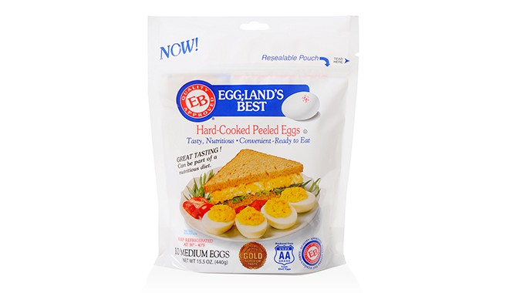
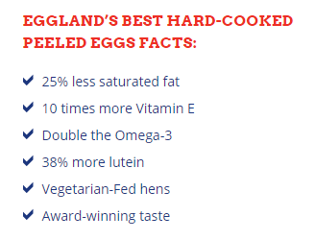
Fresh/Whole/Local/Seasonal | Superfoods
Natural/Org/Clear Label | Proteins
Authentic, Artisan | Grains
Int’l/Regional | Fibers
Sustainable, Eco | Vegetarian/Plant-Centric
Convenience | Healthy Fats
Indulgence | Probiotics
Innovation, Boldness | Vitamins/M/S
Highly Processed, Artificial | Sugar
Artificial Ingredients | Salt
Pesticides | Unhealthy/Excess Fats
Hormones/Antibiotics | Unhealthy/Excess Carbs
Trans Fats/HFCS/GMO | Excess Calories
 | Gluten/Allergens

Slide 19
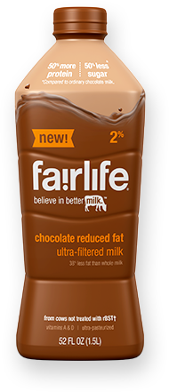
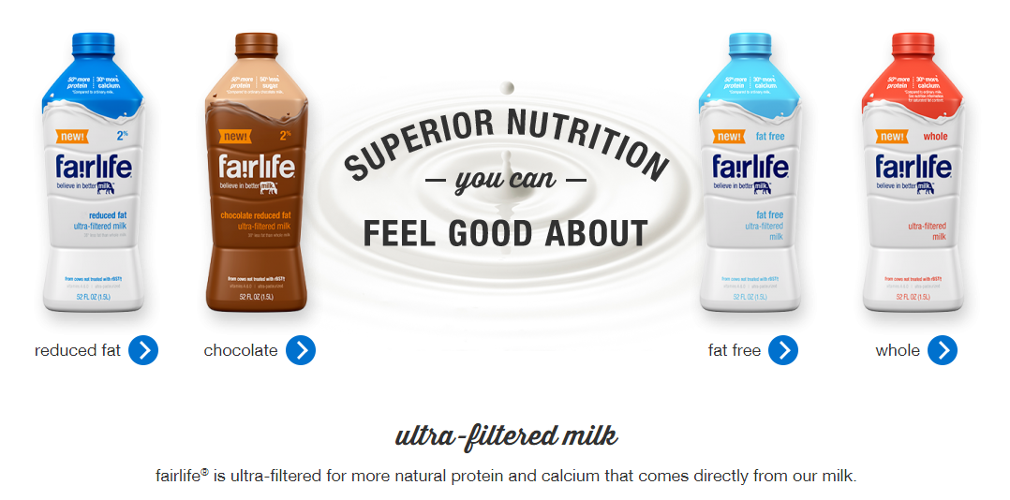
Fresh/Whole/Local/Seas | Superfoods
Natural/Org/Clear Label | Proteins
Authentic, Artisan | Grains
Int’l/Regional | Fibers
Sustainable, Eco | Vegetarian/Plant-Centric
Convenience | Healthy Fats
Indulgence | Probiotics
Innovation, Boldness | Vitamins/M/S
“Industrial” Foods | Sugar
Highly Processed | Salt
Artificial Ingredients | Unhealthy/Excess Fats
Pesticides | Unhealthy/Excess Carbs
Hormones/Antibiotics | Excess Calories
Trans Fats/HFCS/GMO | Gluten/Allergens

Slide 20
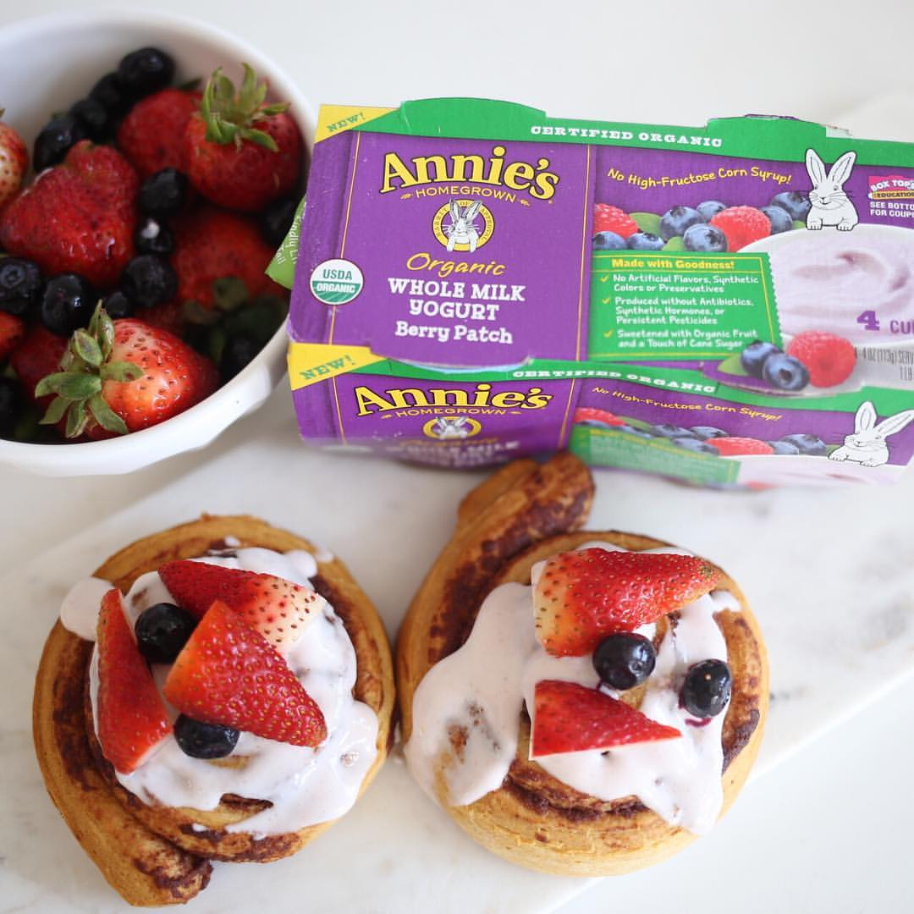
Fresh/Whole/Local/Seas | Superfoods
Natural/Org/Clear Label | Proteins
Authentic, Artisan | Grains
Int’l/Regional | Fibers
Sustainable, Eco | Vegetarian/Plant-Centric
Convenience | Healthy Fats
Indulgence | Probiotics
Innovation, Boldness | Vitamins/M/S
“Industrial “Foods | Sugar
Highly Processed | Salt
Artificial Ingredients | Unhealthy/Excess Fats
Pesticides | Unhealthy/Excess Carbs
Hormones/Antibiotics | Excess Calories
Trans Fats/HFCS/GMO | Gluten/Allergens

Slide 21
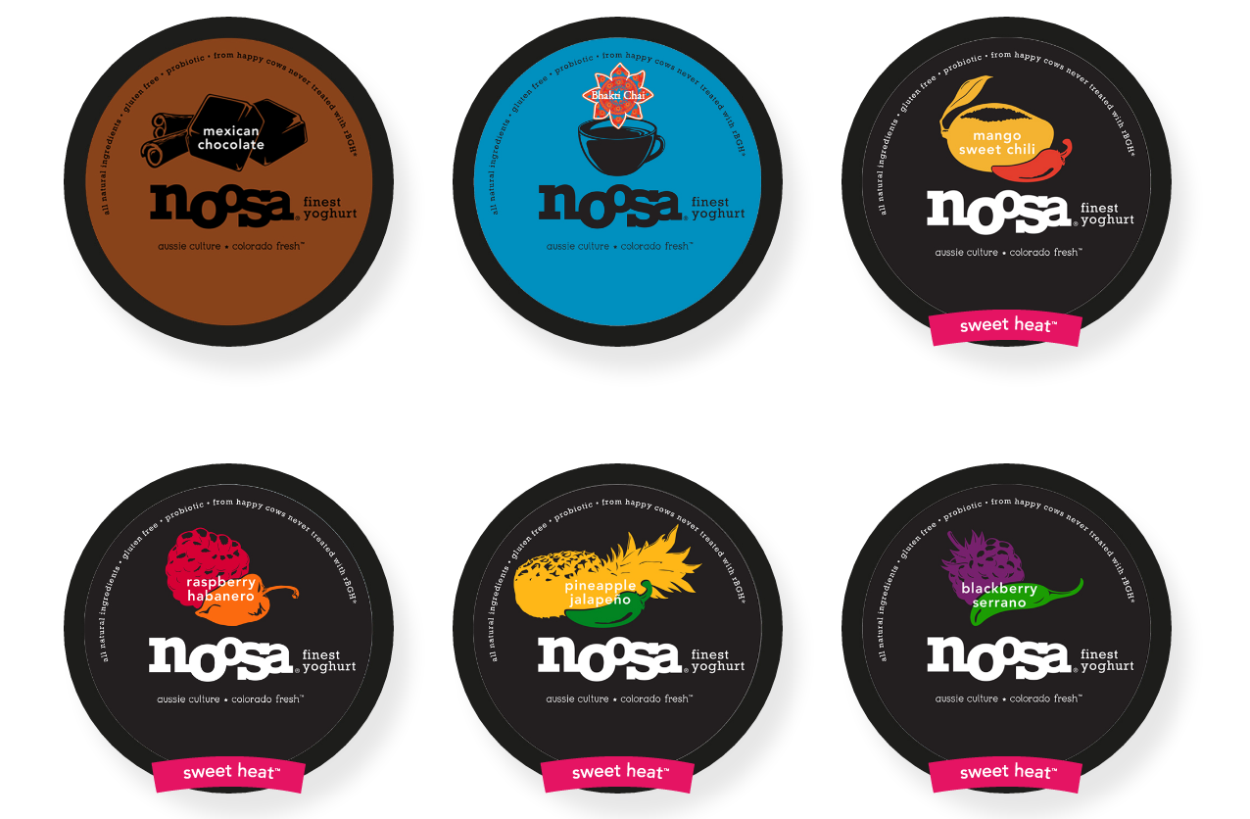
Real/Fresh/Whole/Local | Superfoods
Natural/Org/Clear Label | Proteins
Authentic, Artisan | Grains
Int’l/Regional | Fibers
Sustainable, Eco | Vegetarian/Plant-Centric
Convenience | Healthy Fats
Indulgence | Probiotics
Innovation, Boldness | Vitamins/M/S
“Industrial Foods” | Sugar
Highly Processed | Salt
Artificial Ingredients | Unhealthy/Excess Fats
Pesticides | Unhealthy/Excess Carbs
Hormones/Antibiotics | Excess Calories
Trans Fats/HFCS/GMO | Gluten/Allergens

Slide 22
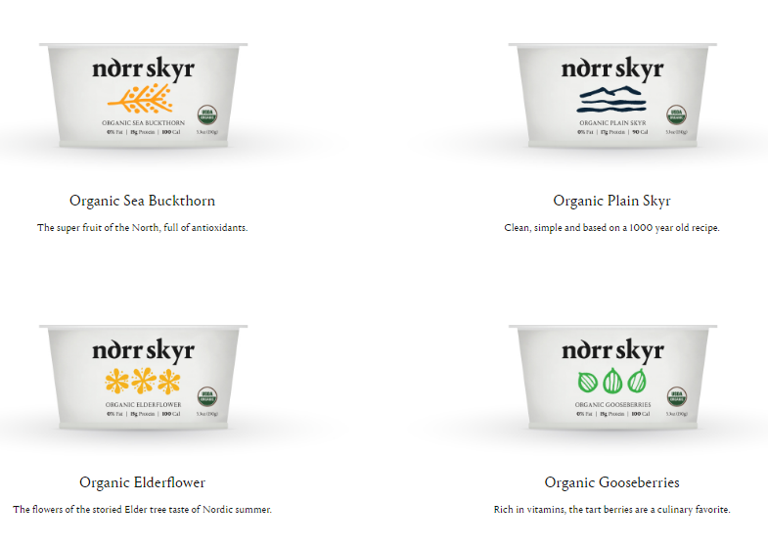
Fresh/Whole/Local/Seas | Superfoods
Natural/Org/Clear Label | Proteins
Authentic, Artisan | Grains
Int’l/Regional | Fibers
Sustainable, Eco | Vegetarian/Plant-Centric
Convenience | Healthy Fats
Indulgence | Probiotics
Innovation, Boldness | Vitamins/M/S
“Industrial” Foods | Sugar
Highly Processed | Salt
Artificial Ingredients | Unhealthy/Excess Fats
Pesticides | Unhealthy/Excess Carbs
Hormones/Antibiotics | Excess Calories
Trans Fats/HFCS/GMO | Gluten/Allergens

Slide 23
Fresh/Whole/Local/Seas | Superfoods
Natural/Org/Clear Label | Proteins
Authentic, Artisan | Grains
Int’l/Regional | Fibers
Sustainable, Eco | Vegetarian/Plant-Centric
Convenience | Healthy Fats
Indulgence | Probiotics
Innovation, Boldness | Vitamins/M/S
“Industrial” Foods | Sugar
Highly Processed | Salt
Artificial Ingredients | Unhealthy/Excess Fats
Pesticides | Unhealthy/Excess Carbs
Hormones/Antibiotics | Excess Calories
Trans Fats/HFCS/GMO | Gluten/Allergens

Slide 24
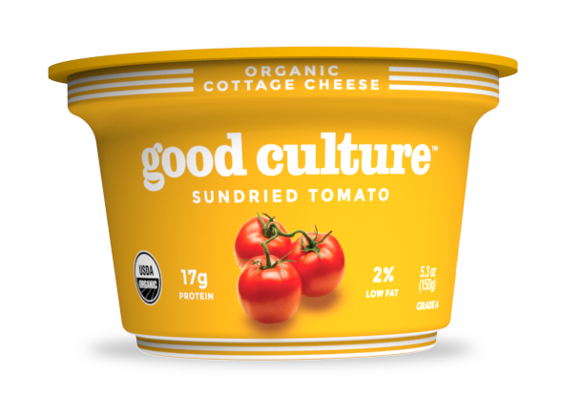
Fresh/Whole/Local/Seas | Superfoods
Natural/Org/Clear Label | Proteins
Authentic, Artisan | Grains
Int’l/Regional | Fibers
Sustainable, Eco | Vegetarian/Plant-Centric
Convenience | Healthy Fats
Indulgence | Probiotics
Innovation, Boldness | Vitamins/M/S
“Industrial” Foods | Sugar
Highly Processed | Salt
Artificial Ingredients | Unhealthy/Excess Fats
Pesticides | Unhealthy/Excess Carbs
Hormones/Antibiotics | Excess Calories
Trans Fats/HFCS/GMO | Gluten/Allergens

Slide 25
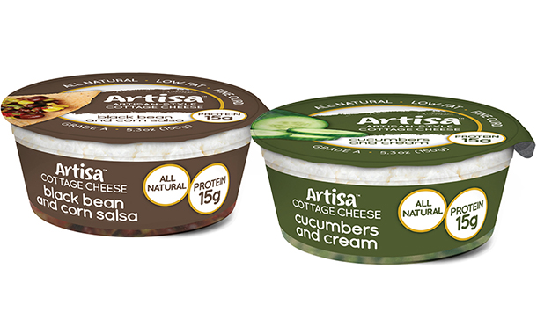
Real/Fresh/Whole/Local | Superfoods
Natural/Org/Clear Label | Proteins
Authentic, Artisan | Grains
Int’l/Regional | Fibers
Sustainable, Eco | Vegetarian/Plant-Centric
Convenience | Healthy Fats
Indulgence | Probiotics
Innovation, Boldness | Vitamins/M/S
“Industrial” Foods | Sugar
Highly Processed | Salt
Artificial Ingredients | Unhealthy/Excess Fats
Pesticides | Unhealthy/Excess Carbs
Hormones/Antibiotics | Excess Calories
Trans Fats/HFCS/GMO | Gluten/Allergens

Slide 26
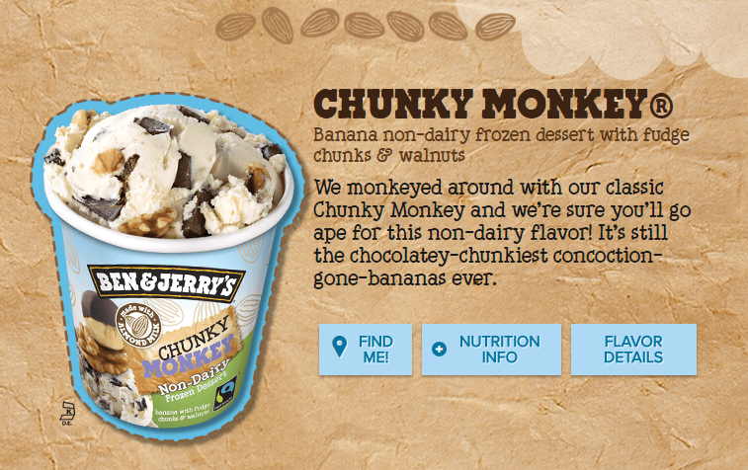
Fresh/Whole/Local/Seas | Superfoods
Natural/Org/Clear Label | Proteins
Authentic, Artisan | Grains
Int’l/Regional | Fibers
Sustainable, Eco | Vegetarian/Plant-Centric
Convenience | Healthy Fats
Indulgence | Probiotics
Innovation, Boldness | Vitamins/M/S
“Industrial” Foods | Sugar
Highly Processed | Salt
Artificial Ingredients | Unhealthy/Excess Fats
Pesticides | Unhealthy/Excess Carbs
Hormones/Antibiotics | Excess Calories
Trans Fats/HFCS/GMO | Gluten/Allergens

Slide 27
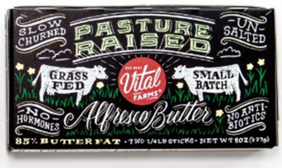
Fresh/Whole/Local/Seas | Superfoods
Natural/Org/Clear Label | Proteins
Authentic, Artisan | Grains
Int’l/Regional | Fibers
Sustainable, Eco | Vegetarian/Plant-Centric
Convenience | Healthy Fats
Indulgence | Probiotics
Innovation, Boldness | Vitamins/M/S
“Industrial” Foods | Sugar
Highly Processed | Salt
Artificial Ingredients | Unhealthy/Excess Fats
Pesticides | Unhealthy/Excess Carbs
Hormones/Antibiotics | Excess Calories
Trans Fats/HFCS/GMO | Gluten/Allergens

Slide 28
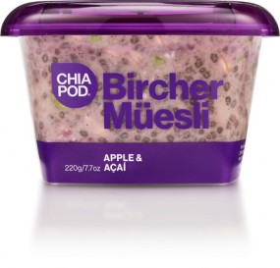
Fresh/Whole/Local/Seas | Superfoods
Natural/Org/Clear Label | Proteins
Authentic, Artisan | Grains
Int’l/Regional | Fibers
Sustainable, Eco | Vegetarian/Plant-Centric
Convenience | Healthy Fats
Indulgence | Probiotics
Innovation, Boldness | Vitamins/M/S
“Industrial” Foods | Sugar
Highly Processed | Salt
Artificial Ingredients | Unhealthy/Excess Fats
Pesticides | Unhealthy/Excess Carbs
Hormones/Antibiotics | Excess Calories
Trans Fats/HFCS/GMO | Gluten/Allergens
dairy-free blend of wholegrain oats and sun ripened chia, mixed with shredded granny smith apple, almond milk, fruits and nuts
lightly sweetened with low-fructose and low-GI coconut sugar, and virgin coconut oil

Slide 29
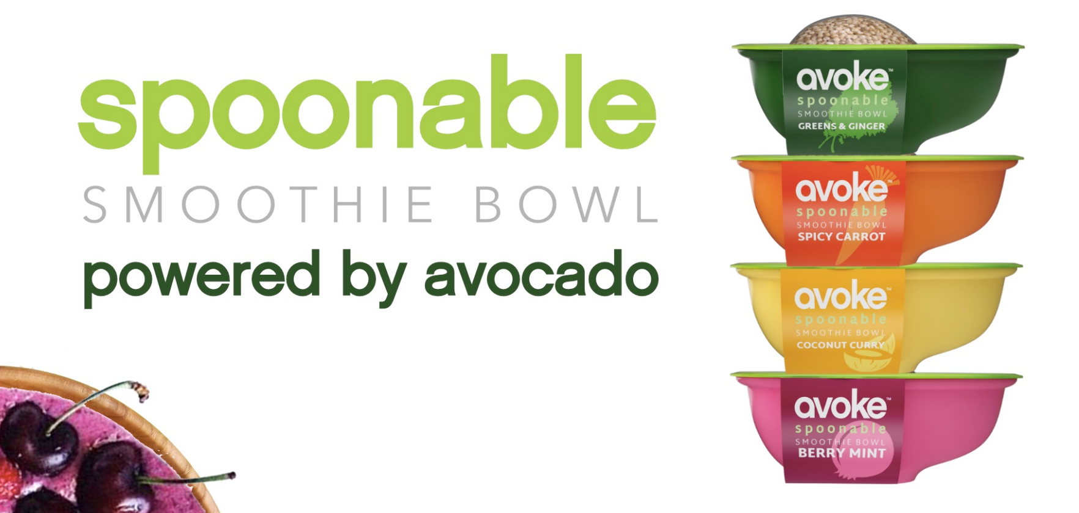
Fresh/Whole/Local/Seas | Superfoods
Natural/Org/Clear Label | Proteins
Authentic, Artisan | Grains
Int’l/Regional | Fibers
Sustainable, Eco | Vegetarian/Plant-Centric
Convenience | Healthy Fats
Indulgence | Probiotics
Innovation, Boldness | Vitamins/M/S
“Industrial” Foods | Sugar
Highly Processed | Salt
Artificial Ingredients | Unhealthy/Excess Fats
Pesticides | Unhealthy/Excess Carbs
Hormones/Antibiotics | Excess Calories
Trans Fats/HFCS/GMO | Gluten/Allergens
First packaged nutrient-rich ‘smoothie bowl’, a high-protein superfood with a crunchy toasted quinoa topping you can eat with
an eco-friendly spoon!
Each Cup is Powered by:
1/2 an Avocado
2 full servings of Fruits & Veggies
Naturally Loaded with up to 10 grams of High Fiber
A Plant Based Source of Complete Protein & Omega 3’s
A Crunchy Toasted Quinoa topping

Slide 30
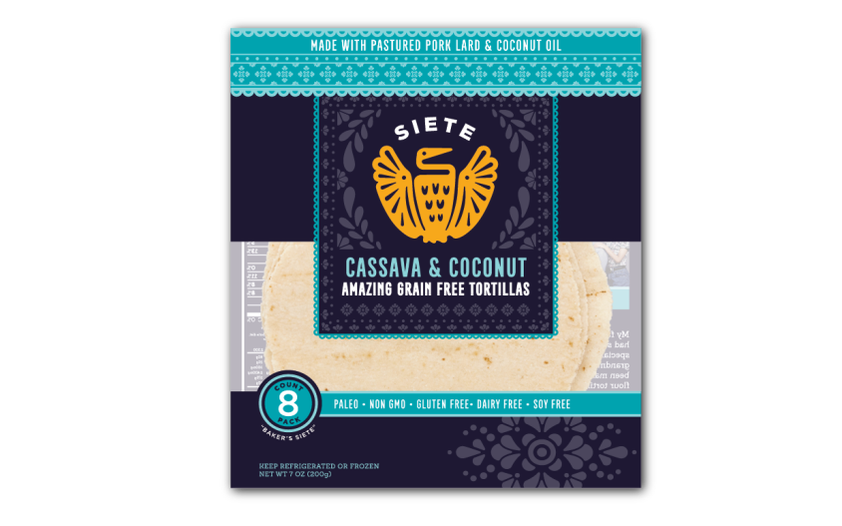
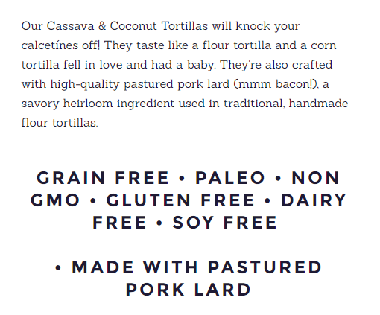
Real/Fresh/Whole/Local | Superfoods
Natural/Org/Clear Label | Proteins
Authentic, Artisan | Grains
Int’l/Regional | Fibers
Sustainable, Eco | Vegetarian/Plant-Centric
Convenience | Healthy Fats
Indulgence | Probiotics
Innovation, Boldness | Vitamins/M/S
“Industrial” Foods | Sugar
Highly Processed | Salt
Artificial Ingredients | Unhealthy/Excess Fats
Pesticides | Unhealthy/Excess Carbs
Hormones/Antibiotics | Excess Calories
Trans Fats/HFCS/GMO | Gluten/Allergens

Slide 31
Fresh/Whole/Local/Seas | Superfoods
Natural/Org/Clear Label | Proteins
Authentic, Artisan | Grains
Int’l/Regional | Fibers
Sustainable, Eco | Vegetarian (Veg Diet)
Convenience | Healthy Fats
Indulgence | Probiotics
Innovation, Boldness | Vitamins/M/S
“Industrial” Foods | Sugar
Highly Processed | Salt
Artificial Ingredients | Unhealthy/Excess Fats
Pesticides | Unhealthy/Excess Carbs
Hormones/Antibiotics | Excess Calories
Trans Fats/HFCS/GMO | Gluten/Allergens

Slide 32
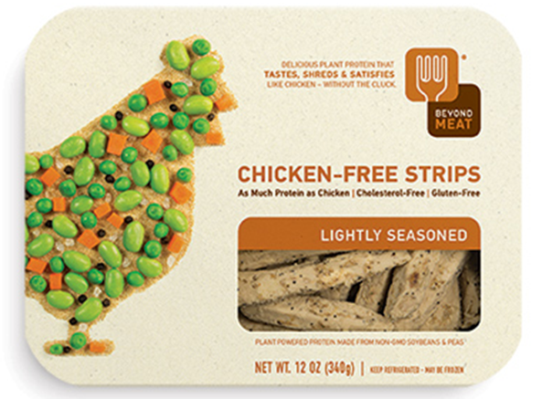
Fresh/Whole/Local/Seas | Superfoods
Natural/Org/Clear Label | Proteins
Authentic, Artisan | Grains
Int’l/Regional | Fibers
Sustainable, Eco | Vegetarian/Plant-Centric
Convenience | Healthy Fats
Indulgence | Probiotics
Innovation, Boldness | Vitamins/M/S
“Industrial” Foods | Sugar
Highly Processed | Salt
Artificial Ingredients | Unhealthy/Excess Fats
Pesticides | Unhealthy/Excess Carbs
Hormones/Antibiotics | Excess Calories
Trans Fats/HFCS/GMO | Gluten/Allergens

Slide 33
Fresh/Whole/Local/Seas | Superfoods
Natural/Org/Clear Label | Proteins
Authentic, Artisan | Grains
Int’l/Regional | Fibers
Sustainable, Eco | Vegetarian/Plant-Centric
Convenience | Healthy Fats
Indulgence | Probiotics
Innovation, Boldness | Vitamins/M/S
“Industrial” Foods | Sugar
Highly Processed | Salt
Artificial Ingredients | Unhealthy/Excess Fats
Pesticides | Unhealthy/Excess Carbs
Hormones/Antibiotics | Excess Calories
Trans Fats/HFCS/GMO | Gluten/Allergens

Slide 34
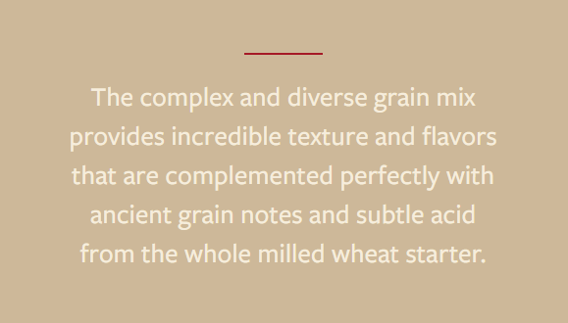
Fresh/Whole/Local/Seas | Superfoods
Natural/Org/Clear Label | Proteins
Authentic, Artisan | Grains
Int’l/Regional | Fibers
Sustainable, Eco | Vegetarian/Plant-Centric
Convenience | Healthy Fats
Indulgence | Probiotics
Innovation, Boldness | Vitamins/M/S
“Industrial” Foods | Sugar
Highly Processed | Salt
Artificial Ingredients | Unhealthy/Excess Fats
Pesticides | Unhealthy/Excess Carbs
Hormones/Antibiotics | Excess Calories
Trans Fats/HFCS/GMO | Gluten/Allergens

Slide 35
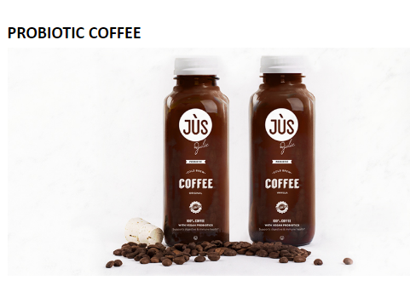
Fresh/Whole/Local/Seas | Superfoods
Natural/Org/Clear Label | Proteins
Authentic, Artisan | Grains
Int’l/Regional | Fibers
Sustainable, Eco | Vegetarian/Plant-Centric
Convenience | Healthy Fats
Indulgence | Probiotics
Innovation, Boldness | Vitamins/M/S
“Industrial” Foods | Sugar
Highly Processed | Salt
Artificial Ingredients | Unhealthy/Excess Fats
Pesticides | Unhealthy/Excess Carbs
Hormones/Antibiotics | Excess Calories
Trans Fats/HFCS/GMO | Gluten/Allergens

Slide 36
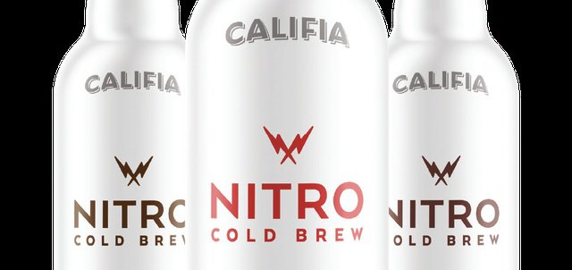
Fresh/Whole/Local/Seas | Superfoods
Natural/Org/Clear Label | Proteins
Authentic, Artisan | Grains
Int’l/Regional | Fibers
Sustainable, Eco | Vegetarian/Plant-Centric
Convenience | Healthy Fats
Indulgence | Probiotics
Innovation, Boldness | Vitamins/M/S
“Industrial” Foods | Sugar
Highly Processed | Salt
Artificial Ingredients | Unhealthy/Excess Fats
Pesticides | Unhealthy/Excess Carbs
Hormones/Antibiotics | Excess Calories
Trans Fats/HFCS/GMO | Gluten/Allergens
Dairy-free Califia Nitro Cold Brew line marries creamy almond and macadamia milks with a cold brew made from a specially-curated, signature blend of direct-sourced beans, and infuses it with a jolt of nitrogen that brings out the natural sweetness of the coffee in a silky micro-foam reminiscent of a dark draft beer. Packaged in a sleek, recyclable, on-the-go aluminum bottle, Califia Nitro Cold Brews come in three on-trend flavors: Latte, Mocha, and New Orleans.

Slide 37
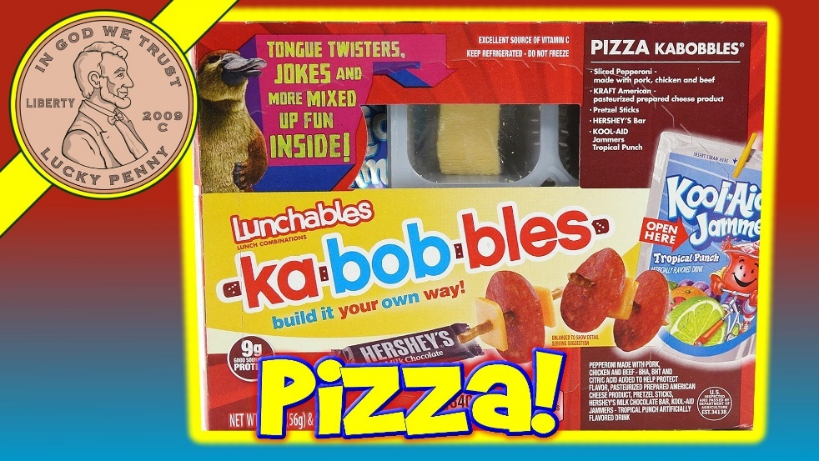
past generation …
new generation …

Slide 38
Takeaways
innovating while maintaining product integrity in ways that resonate with generational population peaks: Boomers & Millennials
catering to special diets & ingredient avoidances and crafting a positive/negative claim balance
bridging the gap between fresh, whole, natural and cooked-from- scratch foods and packaged food products
winning over customers with transparency and off-label information

